Slide 1
Research Methodology- Unit 5 DATA COLLECTION AND ANALYSIS
Prime College- BIM 6th Semester

Slide 2
Research Methodology- Unit 5 Chapter 3- Research Interviews
Prime College- BIM 6th Semester

Slide 3


Learning Outcome 1
Research interviews
Face-to-face interviews
Telephone interviews
Computer assisted interviewing

Slide 4
Research Interviews
The interview is simply a conversation between two persons for a particular purpose.
A research interview is a two–person conversation initiated by the interviewer for the specific purpose of obtaining research–relevant information and focused on content specified by research objectives of systematic description, prediction, or explanation.
It is regarded as a face-to-face interpersonal interaction in which an interviewer asks respondents several questions designed to obtain answers to research questions. In an interview, the interviewer uses an interview schedule, i.e., a list of questions or guidelines indicating which questions should be asked.
Reliability of the data collected through interviews remains higher than that of mailed questionnaires.
Forms of Interview:
Scheduled-structured Interview: the questions, wording, and sequence of questions are fixed.
Non-Scheduled-Structured Interview: the interviewer can use subjective judgment during the interview
Non-directive Interview: neither pre–a specified set of questions nor specific ordered questions.

Slide 5
Major Considerations While Developing Interview Questions
1. The wording of the question
2. Formats of interview schedule
i. Open-ended questions
ii. Fixed–alternative questions
The objectives of the interview
The respondent’s level of information
The extent to which respondents have clear and structured Ideas
The extent to which the respondent is motivated to communicate
iii. Scale items
3. Leading questions
4. The sequence of questions
i. Funnel sequence
ii. Inverted funnel sequence

Slide 6
Major Considerations While Developing Interview Questions
The wording of the question
Questions for the interview can be worded so that the respondent can comprehend them in the same way that the researcher intended to do. The vocabulary used by the interviewer should be understandable to the targeted interviewee. For example:
Q1: Do you agree that Mr. A is a charismatic leader?
Q2: Do you consider yourself liberal?
Vocabulary used in the above-mentioned examples, like charismatic and liberal, would not be understandable by normal people. Avoid jargon words, multi–meaning words, and technical words unnecessarily as far as possible.

Slide 7
Major Considerations While Developing Interview Questions
2. Formats of interview schedule
i. Open-ended questions
Do you have any contacts with any faculty member outside of classes? (Kerlinger, 1973, p.484)
a. (If yes) How often is that?
b. What is the nature of your contacts (social, counseling, and so on)?
c. Are you generally satisfied with the amount of personal contact
you have with members of the faculty?
d. (If no) What would you like to see done about it?
Advantages of open-ended questions
 flexible method
 If a misunderstanding arises, it is possible to clear it through probing.
 They enable the interviewer to ascertain the respondent's lack of
knowledge, delete ambiguity, encourage cooperation, and achieve
rapport.
 This method helps to make better estimates of the respondent's beliefs,
intentions, and attitudes.

Slide 8
Major Considerations While Developing Interview Questions
2. Formats of interview schedule
ii. Fixed–alternative questions:
For instance, to measure group cohesiveness among the group members, seashore (1954) asked, ‘Do you feel that you are part of your work group?’
 A part of my work group
 Include in most ways
 Included in some ways but not in others
 I don’t feel I belong
 Don’t work with any one group of people
 Not ascertained (Nachmias&Nachmias, 1976).
Advantages of open-ended questions
gives greater uniformity of measurement, which ultimately gives more excellent reliability.
easy to ask the questions to respondents and answer the questions by respondents.
No writing is necessary from the side of the interviewer as well as respondents.
Drawbacks
information generated from this method is somewhat superficial
may introduce bias by forcing the respondent to choose from given choices

Slide 9
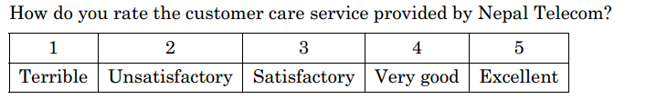
Major Considerations While Developing Interview Questions
2. Formats of interview schedule
iii. Scale items:
Scale is the level of an individual responding or the degree of satisfaction expressing or some other mode of response to the given statement.
Scale items have fixed alternatives and place the responding individual at some point on the scale. This interview format uses a scale and asks the respondent to rank certain variables on a scale.
For example:

Slide 10
Major Considerations While Developing Interview Questions
3. Leading questions
For example, a question designed to elicit general attitudes toward social protest might be:
Q1: How do you feel about student protest?
The same question might be rephrased in a leading form as:
Q2: You wouldn't say you favored student protest, would you?
A more subtle form of leading question might be:
Q3: Would you say you do not favor student protest?
If respondents are seeking undistorted questions, leading questions should be
avoided. But based on the nature and circumstances of the study, in some
cases, leading questions may serve the research objectives too

Slide 11
Major Considerations While Developing Interview Questions
4. The sequence of questions
The interview schedule is a set of questions developed to facilitate research interviews and serve the research purpose.
Funnel Sequence
For example:
If a researcher is interested in studying how respondents’ views regarding social problems are related to the newspapers they read, some possible funnel-sequenced questions may be:
Q1: What do you think are the most critical social problems facing the nation?
Q2: Which is the most important of the problems you have just mentioned?
Q3: Where do you find most of the information about this problem?
Q4: Do you read the Kathmandu post regularly for such social problems?
Inverted funnel sequence:
It is just the reverse of the funnel sequence in which broader questions follow specific questions.
Simply, questions are arranged from specific to general or narrower to broader.

Slide 12
Types of Research Interview
Advantages
 Response rate in this method can be maintained high.
 More accurate because the interviewer
 Possible to collect supplementary information
 Questions in a delicate situation can usually be handled more effectively.
 The language of communication can be adjusted to the status and educational level of the respondent.
Drawbacks
 Costly and time-consuming
 The interviewer must be skillful and well trained.
 The risk of personal prejudice and bias
Face–to–face interview:
In a face–to–face interview, the interviewer and
interviewee communicate face-to-face directly at an office or desired place of the respondent.
The face–to–face method is the most common method of obtaining primary data through an interview schedule.
Under this method, the interviewer gets information and a facial response to the question.
direct information can be taken with higher reliability

Slide 13
Types of Research Interview
Advantages
 helpful in interviewing the respondents located over the wide geographical area and the short time available for interview.
 An inexpensive method
 A flexible method with most of the strengths of a face–to–face interview at a low cost.
 Have higher response rate and accuracy..
Disadvantages
 Not useful when a telecommunication facility is not available.
 The interviewer cannot read the respondent’s reaction, like facial expression and situational variables, i.e., surroundings.
 Open–ended questions are challenging to use in a telephone interview.
 Questions requiring visual aids are impossible to use.
2. Telephonic interview
This method of interview is solely based on access to information and communication technology.
With technical advancement and the widespread of IT and ICT, data collection assisted by telephone interviews
In this method, the interviewer makes contact with the sampled respondent and pre–confirms the time availability for the interview, then sets the interview at the allocated date and time with or without a structured schedule.
In short, the interviewer calls a respondent, asks questions, and records the response.

Slide 14
Types of Research Interview
Advantages
 Respondents can read or hear enough of the questions.
 Questions can be prerecorded, and the audio can be played back for the respondent.
 Respondents can give responses on more sensitive issues as well.
Disadvantages
 Respondents must use a highly confidential method of responding.
 Only highly competent respondents can use a computer to provide information.
3. Computer-assisted interview
If the respondent or interviewer uses a computer to answer interview questions, the interview is called computer–assisted interviewing (CAI).
It is a technique for survey data collection in which the respondent uses a computer to complete the survey questionnaire without an interviewer administering it to the respondent.
It is similar to computer–assisted telephone interviewing, except that the interview takes place in person instead of over the telephone

Slide 15
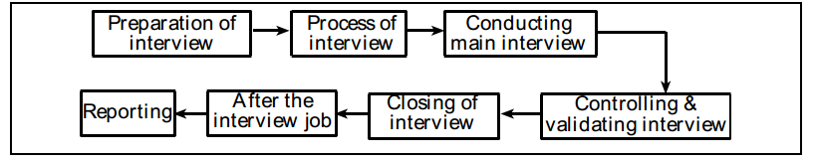
Steps in Research Interview

Slide 16
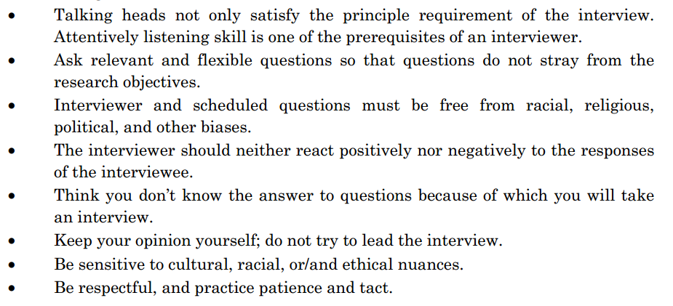
Principles of Interviewing

Slide 17
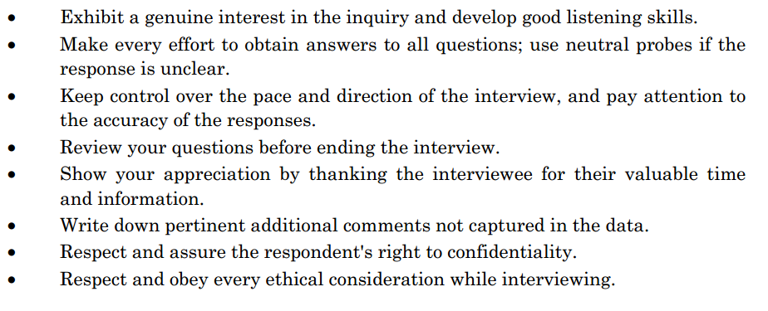
Principles of Interviewing

Slide 18
End of Chapter 3
(Click the arrow when in Slide Show mode)
Notes:
In Slide Show mode, click the arrow to enter the PowerPoint Getting Started Center.

